Slide 1
What does it mean to be human?

Slide 3
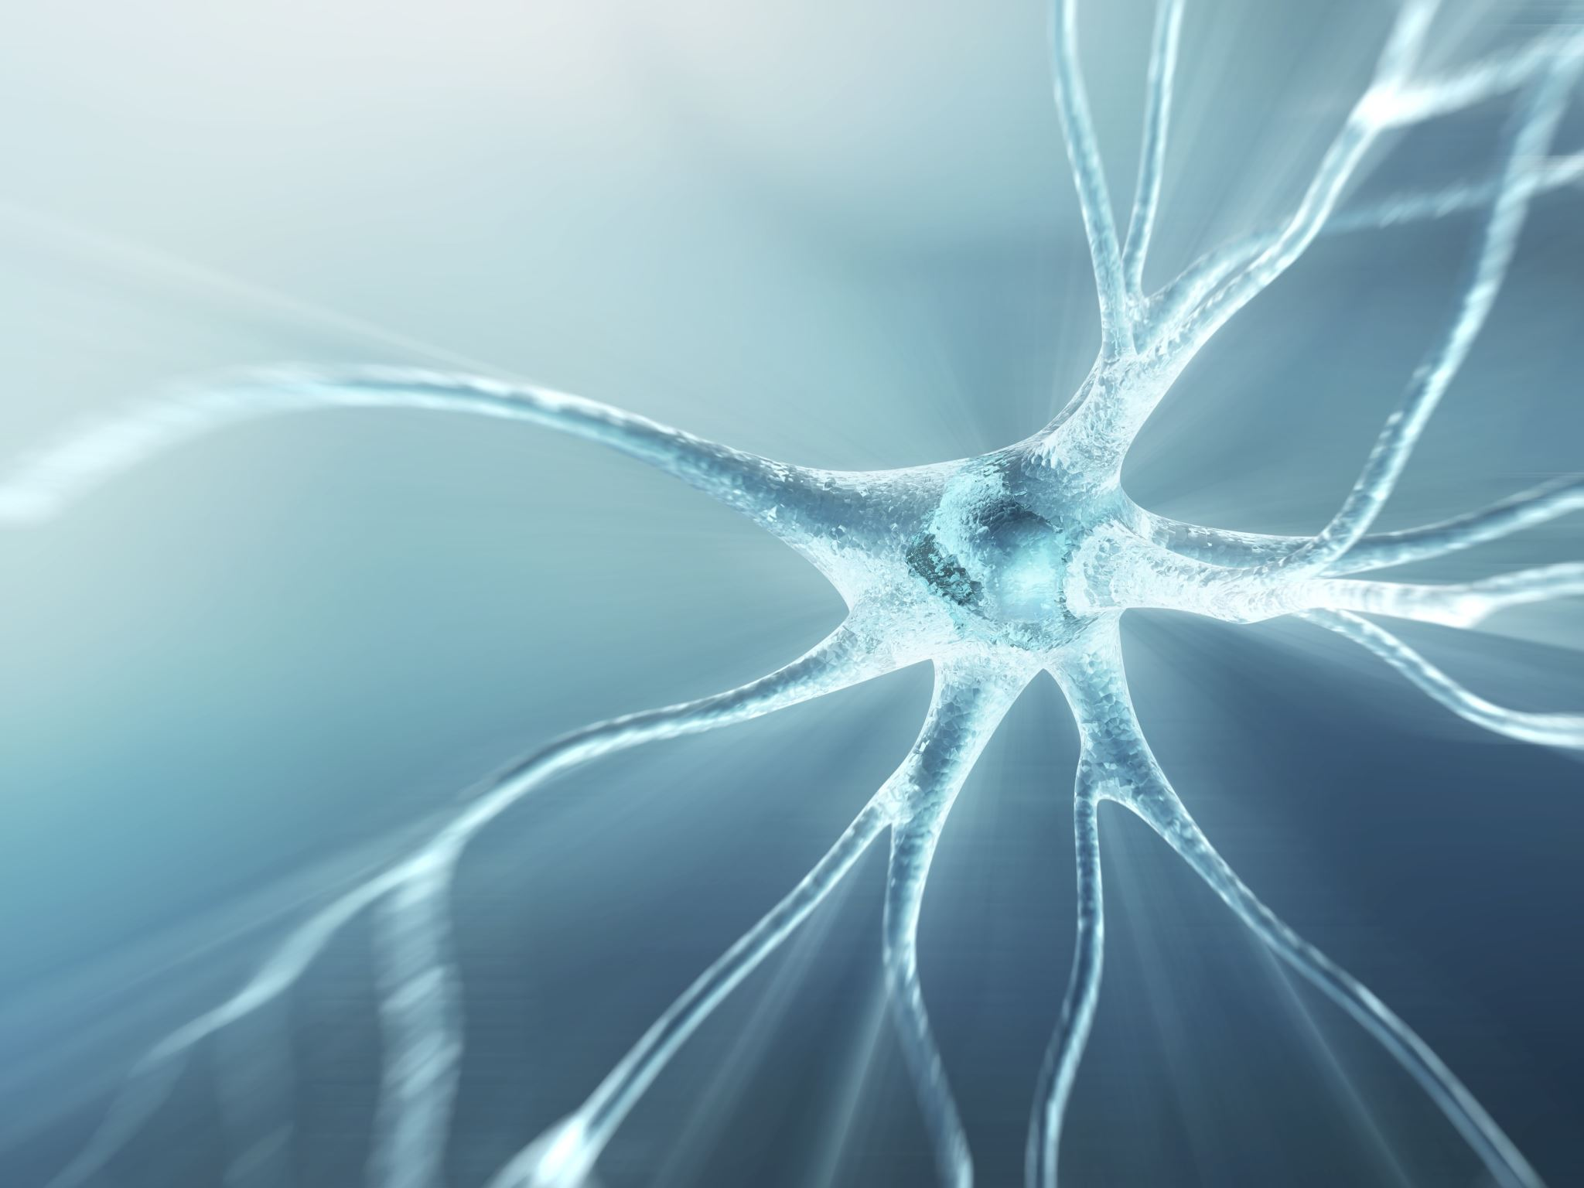
Origin Stories and Creation Myths

Slide 4
Myth: The world’s oldest stories
muthos = story(Greek)
Origins are uncertain
-anonymous
-generated and perpetuated by cultures through the oral tradition.

Slide 5
Not intended to be recorded history of events… …but rather a reflection of a people and culture, of values and beliefs.
Myths “Portray more effectively…how a given culture perceives and organizes the world around it.”
Allows us “a valuable probe into the worldview and values of a particular culture.”
-Gleiser

Slide 7
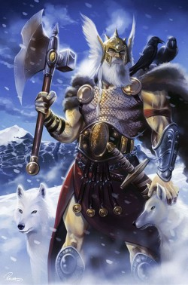
Myths…
Explain the origins of the universe and life
Explain a natural phenomenon—why is the sky blue, what are stars
Explain the human condition—flaws, suffering, death, hope, resilience…
Explain historical events
Teach morality

Slide 8
Myths explain these elements through the involvement of a pantheon of deities (gods and goddesses), providing a system of religious beliefs and practices.
These myths are passed along by leaders, elders, or religions figures.

Slide 9
Origin Myths and Archetypes
An Archetype: a pattern or model that serves as the basis for different but related versions of a character, plot, or theme.
Origin stories explain how events, actions, or objects came into being, featuring common archetypes found universally in myths from around the world.

Slide 10
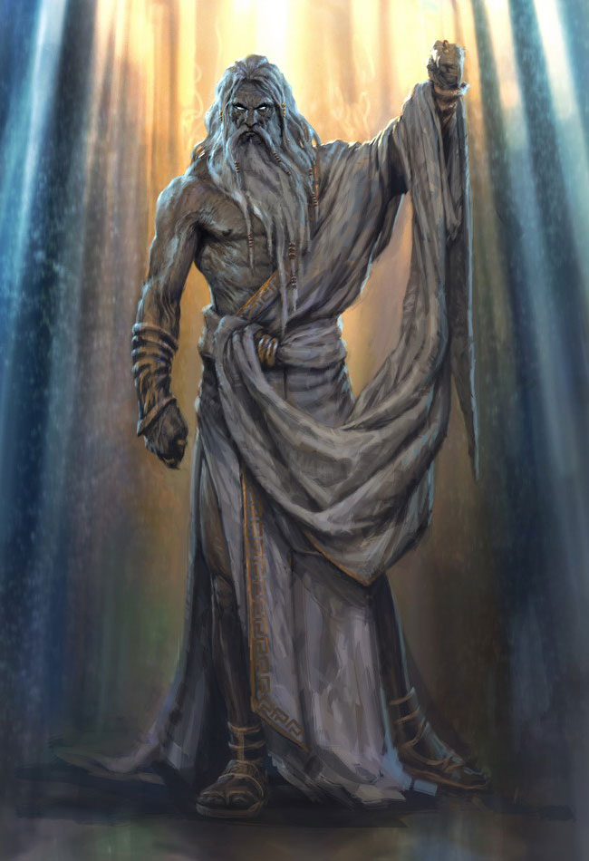
Familiar Archetypes:
Creator figure (god or goddess)
Water
Golden Age
A Trickster
Talking Animals (spiritual guides)
Sibling Rivals and/or Sibling Mates

Slide 11
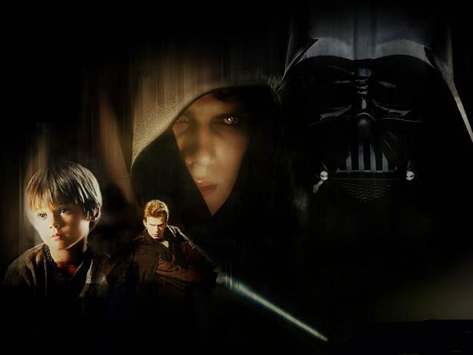
Familiar Archetypes:
Fall From Grace (loss of paradise)
Great Destruction
Female Earth
Creation From Body Parts
Perfect Numbers (2, 3, 4, 7, 12)

Slide 12
Sample Archetypes:
Fall From Grace
Trickster
Great Destruction
Golden Age
Adam and Eve, Satan, Anakin Skywalker
Loki, the serpent, Raven, Bugs Bunny, Merlin
Flood, SkyNet, Armageddon
Asgard, Middle-earth

Slide 13
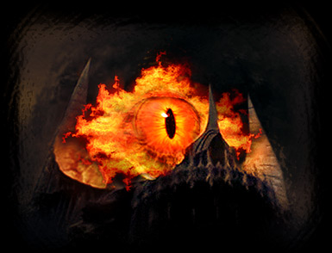

Slide 14
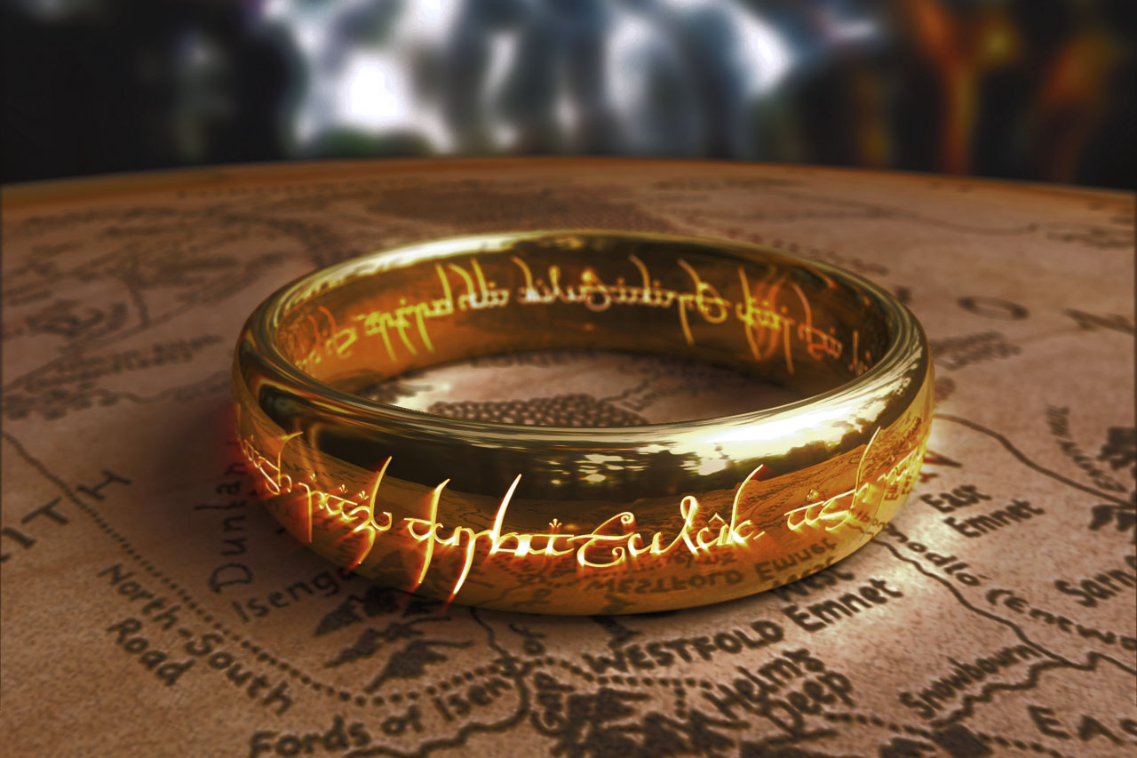
Origin Myths give people a sense of their place in the universe…
Who they are
Where they come from
What their destiny will be

