Slide 1
Recipe for a civilization

Slide 2
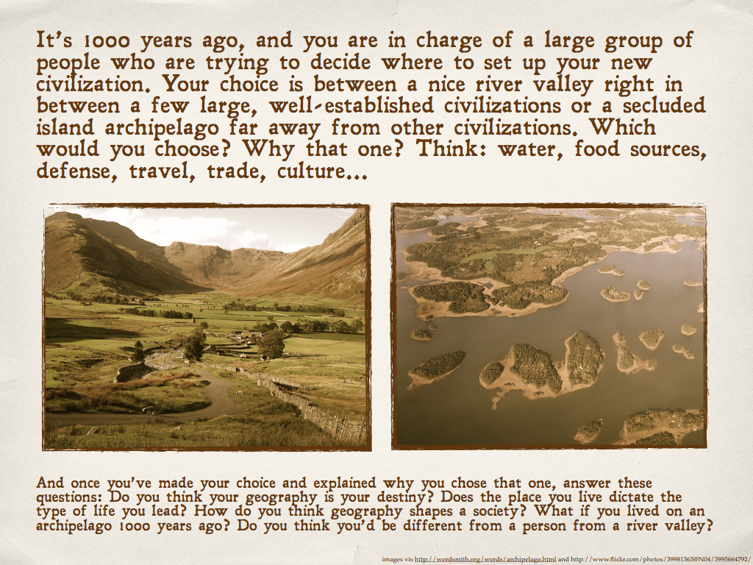

Slide 3
What factors led to the rise of civilizations?
Civilization – Video notes and discussion
Warmer climate
River – water supply – farming and irrigation
Grass!!!!!! - oat, rye, millet, rice, corn
Domestication of herd animals – food, milk, power
Hub settlements
Creation of alpine belts and mountains – snow – water supply

Slide 4
Civilization – Video and discussion notes: What are the Characteristics of civilization?
Sustainable and reliable agriculture or food sources
Specialized labour – potters and brick makers
Writing and recordkeeping
Laws and government
Stricter hierarchy – social class – elite
Leader – kingship
Military
Empire
Common beliefs
Culture – characteristic art, rituals,
Common language

Slide 5
Civilization – Video and discussion notes: How does geography affect human society?
Continental shift – forming rivers, mountains, seas – impacted development of trade routes
Fertility of a region – animals and plants
Travel and communication – Nile (flows south to north; winds travel north to south)
Ice age prevented civilization from emerging earlier
Latitudinal climate bands – allowed for domesticated crops and animals to spread across regions

Slide 6
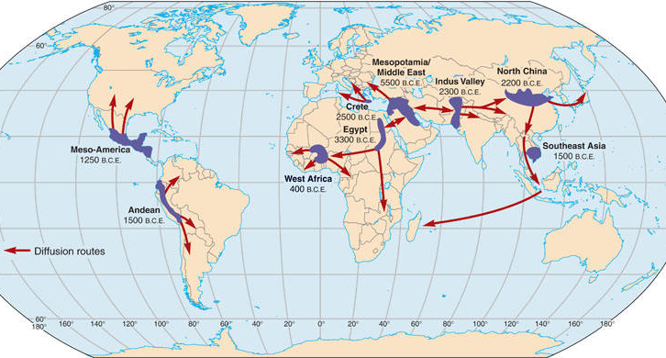

Slide 7
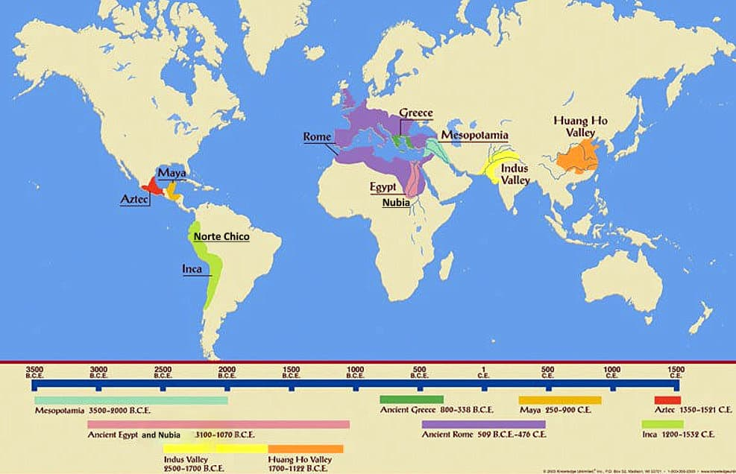

Slide 8
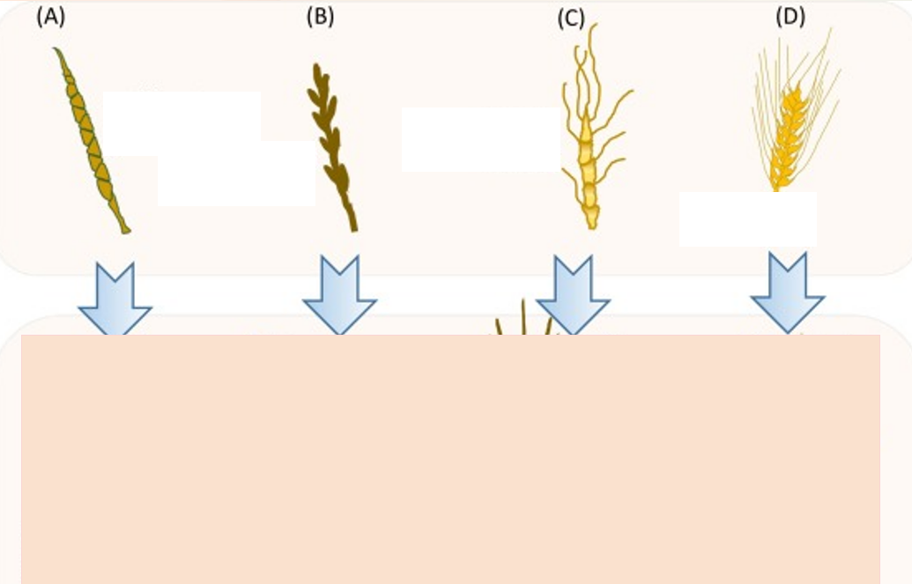

Slide 10
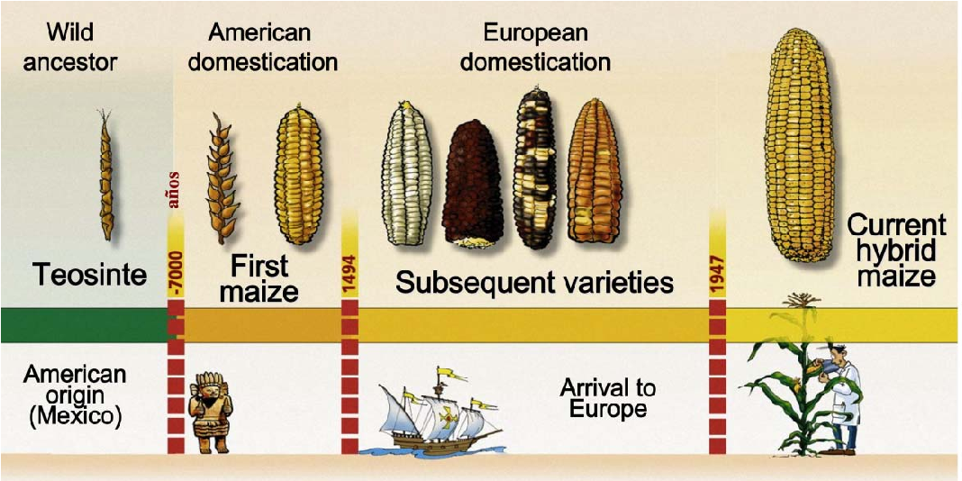

Slide 11
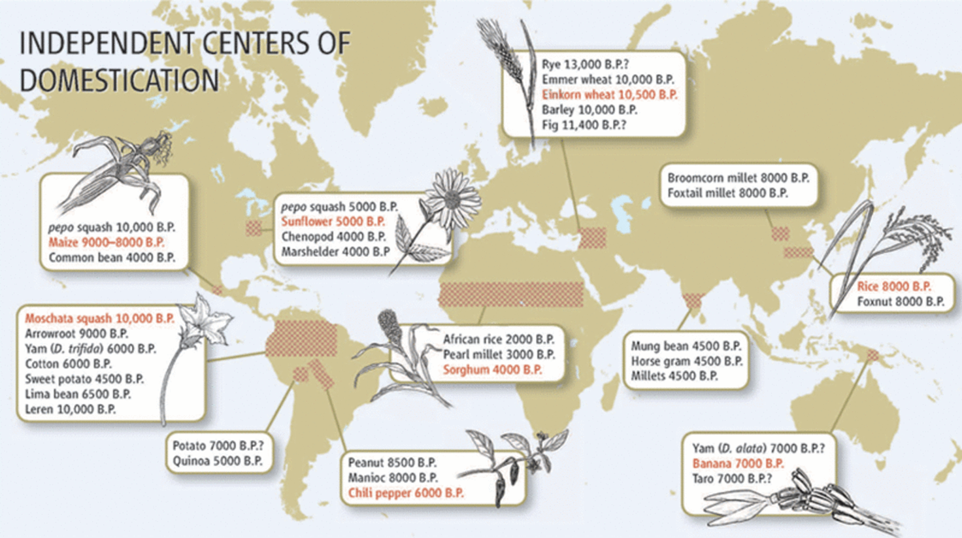

Slide 12
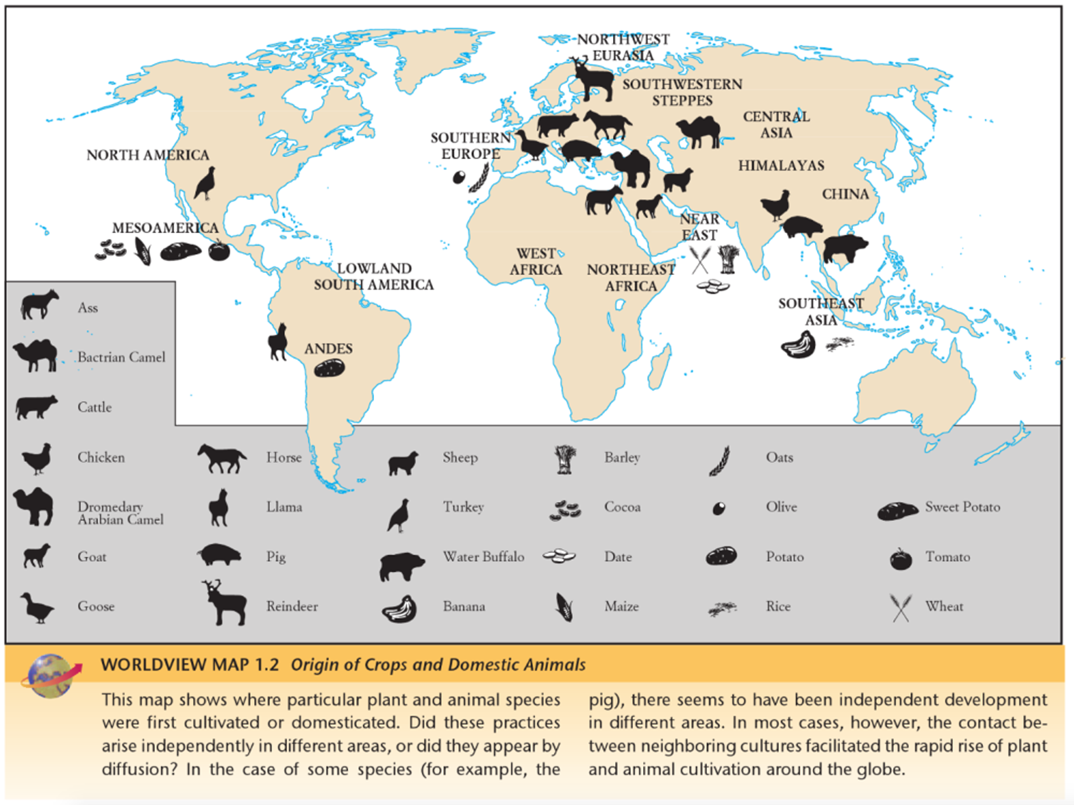

Slide 13
Be ready to answer.
5,000

Slide 14
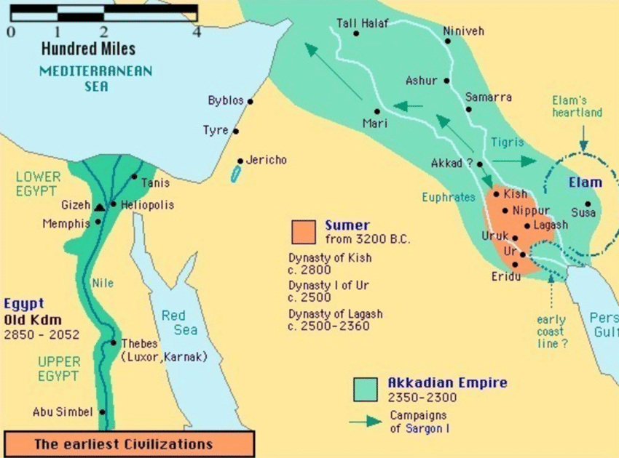

Slide 15
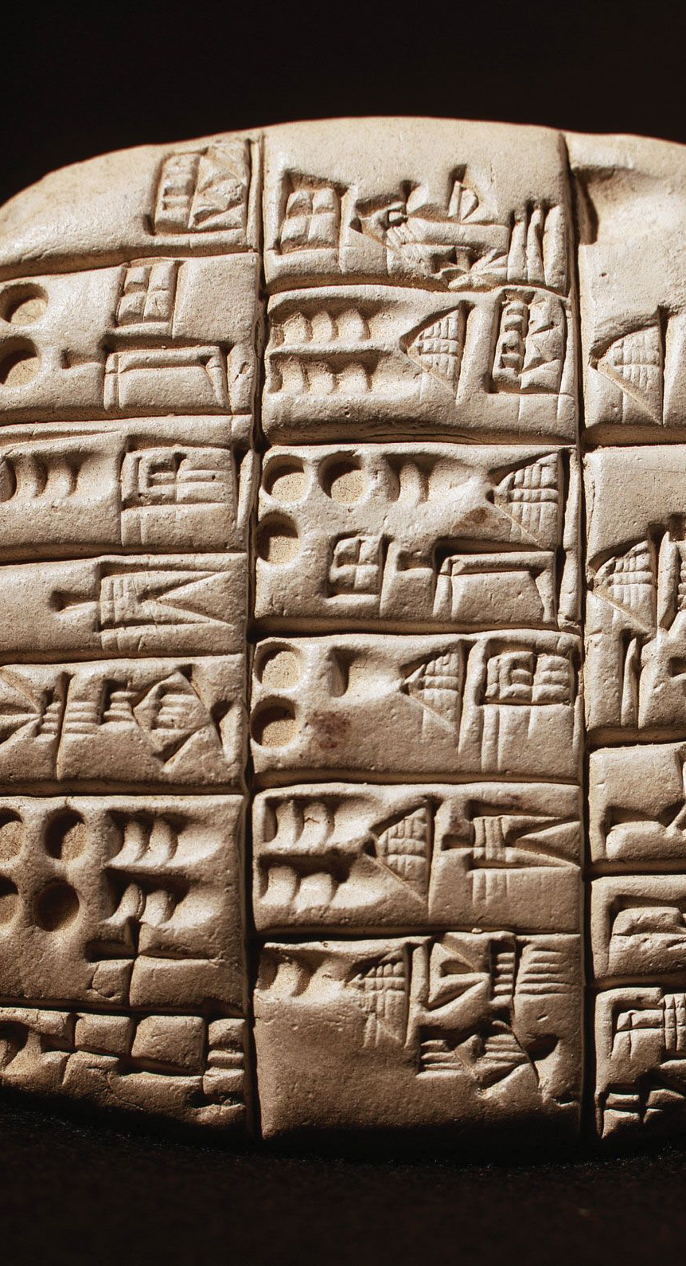
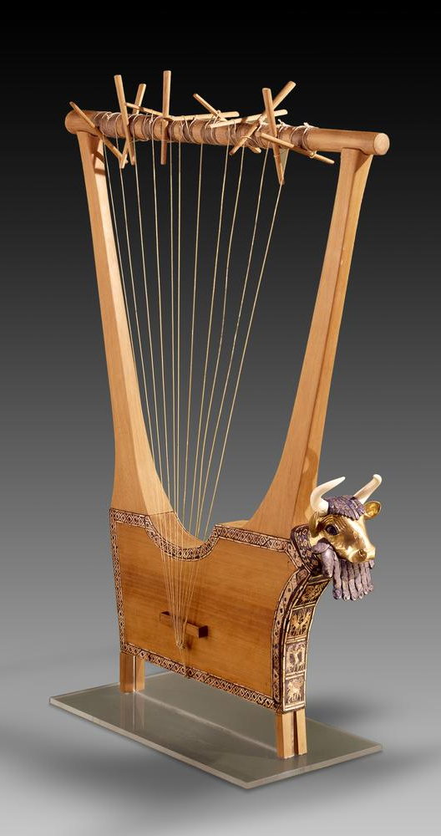
Sumer(3,200 BCE)
A land of firsts
First writing – Cuneiform
Mapped stars and constellations
Wheel
Abacus
Loved music(lyre) and magic
Mathematics – base 6

Slide 16
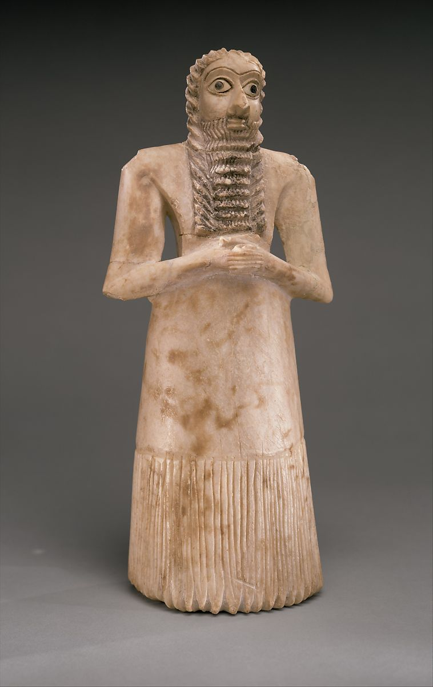
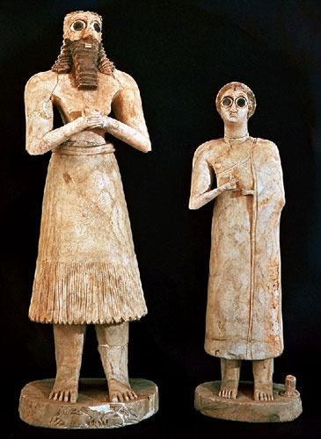
Imagine you are an anthropologist who is interpreting these statues. What might these statues tell us about the history of the Sumerian people?

Slide 17
Some background – These are devotional statues that would be commissioned and then placed in a ziggurat(temple). These temples were at the centre of Sumerian cities, and as far as we know, access was limited to the priests.

Slide 18
Observations and inferences?
Clothing – different styles for men and women
Men and women included
Purpose – devotional statues – religion was central
all feature clasped hands – a symbolic gesture

Slide 19
Some more background…
There have been 100s of these figures found – similar in characteristics, but different in style.
-Suggests the possibility of different workshops
-a specialized trade
The name of the god, the donor and their profession is carved on the back of each statue.

Slide 20
What do these statues tell you about social structure, hierarchy and religion?
Religion was central to life
It was important to show devotion to the gods
Only the elites could afford to have these statues (for the most part)
Priests had a powerful role as the intermediaries to the gods.

Slide 22
Final question
How is religion in Sumerian society different from religion during paleolithic times?

Slide 23
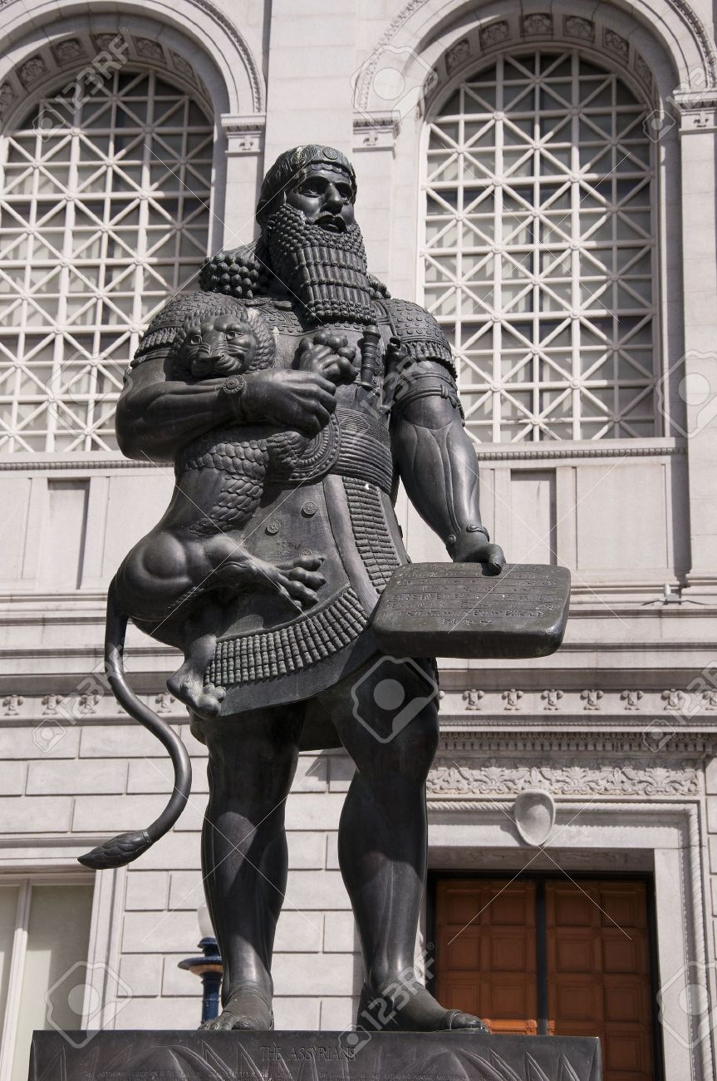
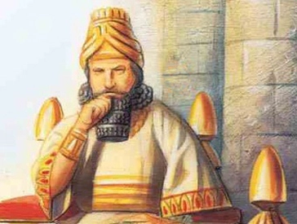
Hammurabi
Hammurabi was the King and founder of the Babylonian empire [2000 BC – 1680 BC]
Nomadic warriors overtook the Sumerians.
In 1790 BC, king wrote the world’s first large collection of laws.

Slide 24
Hammurabi receiving the legal code from the god Shamash. Which one is Hammurabi?

Slide 25
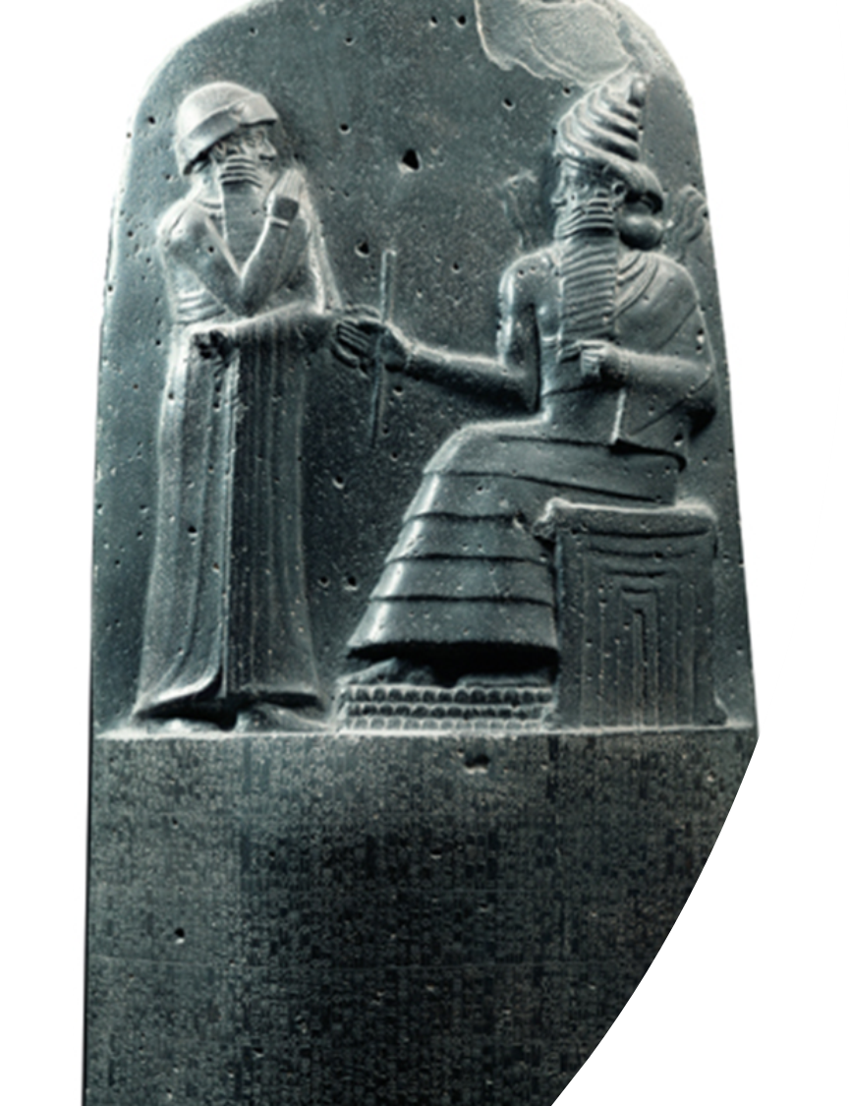
The inscription
Hammurabi, the king of righteousness, on whom Shamash has conferred the Law, am I.
When Marduk sent me to rule over men,
to give the protection of right to the land,
I did right and in righteousness brought about
the well-being of the oppressed.
code contained 282 laws
settled conflict in ALL areas of life

Slide 26
If a man has destroyed the eye of a member of the aristocracy, they shall destroy his eye. If he has broken another man’s bone, they shall break his bone. If he has destroyed the eye of a commoner or broken the bone of a commoner, he shall pay one mina of silver. If he has destroyed the eye of another man’s slave or broken the bone of a man’s slave, he shall pay one-half of the slave’s value.

Slide 27
Assignment
You will be looking a number of legal scenarios, and examining how they would have been dealt with under Hammurabi’s reign.
You will also be examining the laws to see what they will reveal about law and order in ancient Mesopotamia.
Will be posted on the website and a notice on Teams.

Slide 28
Reminders
Friday, December 4th
1)Paragraph comparing and contrasting culture and civilization
2) Mesopotamia – ppt package
3) Hammurabi’s legal code assignment
Monday, December 7th
Early Civilizations comparison (assigned on Thursday)
Tuesday, December 8th – Test(yay!)

Slide 29
And that’s all today folks!
Enjoy the rest of the day.
See you Thursday.

